Slide 1
Space Exploration Through Data

Slide 2
Cassini-Huygens mission
Cassini was a collaboration between NASA, the European Space Agency (ESA), and the Italian Space Agency (ASI) to study the Saturn system
The mission was the most comprehensive effort to gather data from Saturn and its moons as it was the 4th probe to travel to Saturn but the 1st to enter its orbit
Originally planned to last 4 years, the mission ultimately lasted from October 15, 1997 to September 15, 2017

Slide 3
Cassini Data Objectives
Cassini carried 12 data collection instruments and gathered data for 27 scientific investigations, including:
Composite Infrared Spectrometer
Imaging Science Subsystem
Ultraviolet Imaging Spectrograph
Visible and Infrared Mapping Spectrometer
Cassini Plasma Spectrometer
Cosmic Dust Analyzer
Ion and Neutral Mass Spectrometer
Magnetospheric Imaging Instrument
Radio and Plasma Wave Science
Radar Imaging
Radio Science Microwave

Slide 4
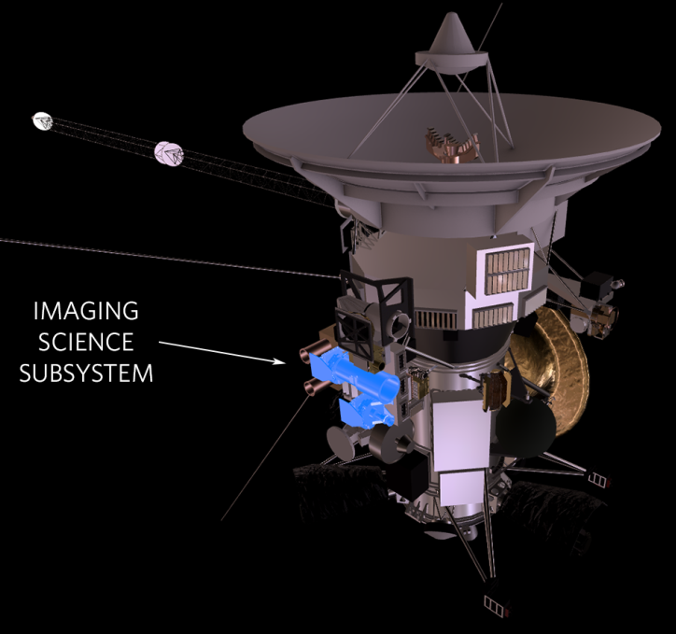
Data Collection
635 GB of data collected
Among the many instruments collecting data, the Imaging Science Subsystem (ISS) captured wavelength measurements which were transmitted to the Jet Propulsion Laboratory (JPL) for interpretation
ISS captured data for 453,048 images

Slide 5
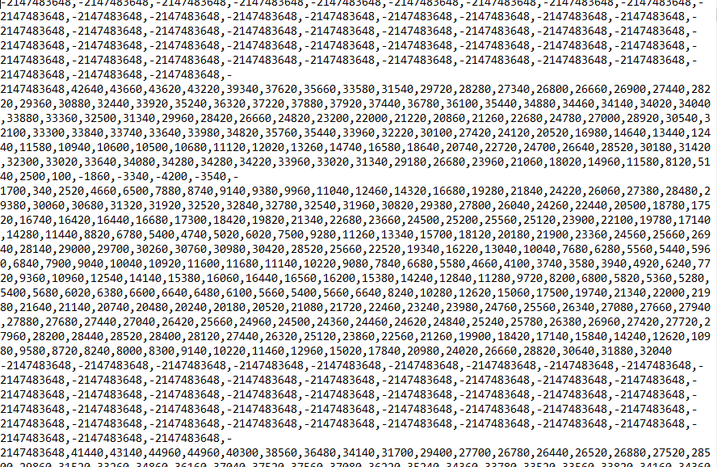
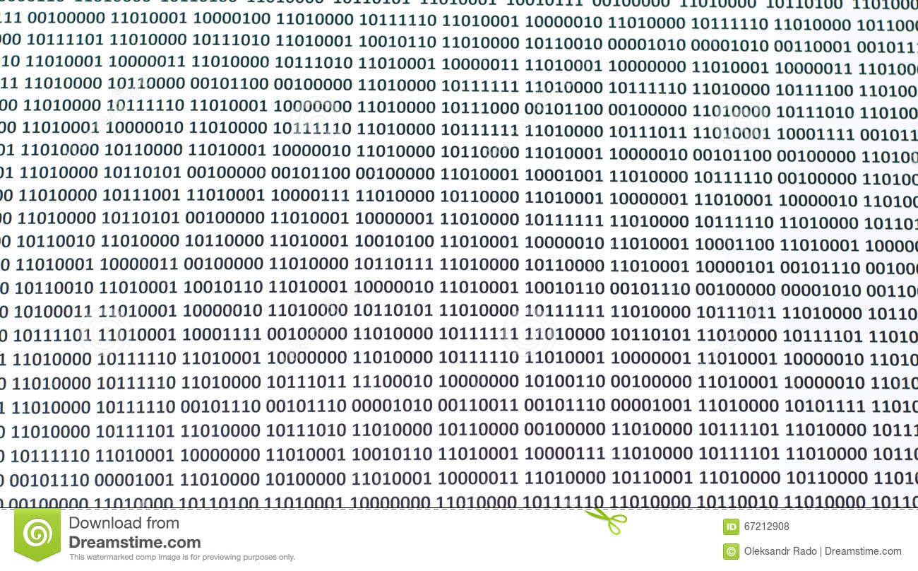
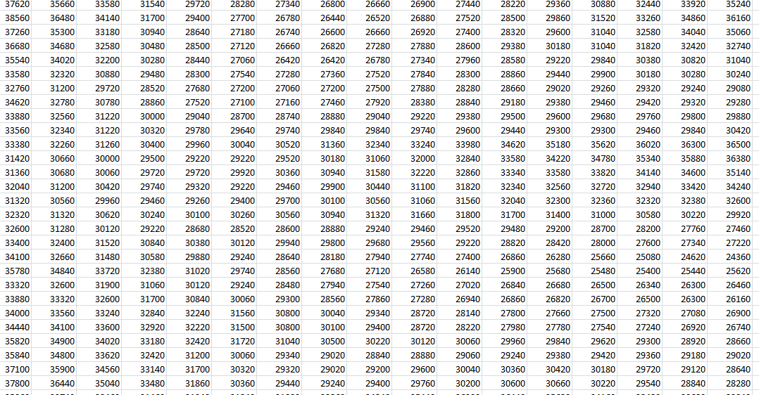
Data Interpretation
JPL researchers and analysts first converted the digital signal into interpretable numeric formats

Slide 6
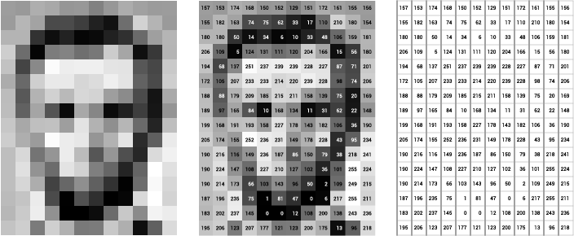
Data Conversion
Image processing technique can turn numeric data into pixels which can then be converted into a raw image (example below)

Slide 7

Data Conversion (cont.)
Signal data processed this way can produce an image like this:

Slide 8
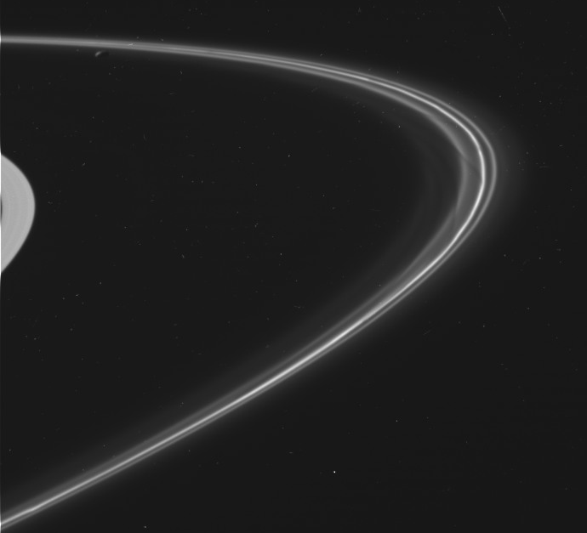
Data Merging
Combining multiple datasets can produce larger images, similar to assembling a puzzle

Slide 9
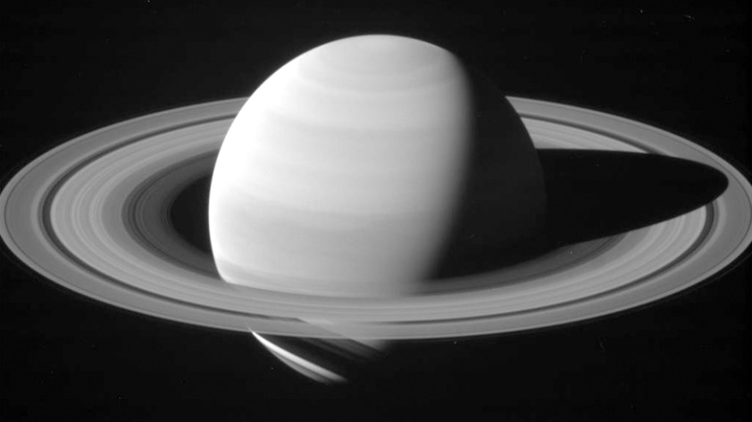
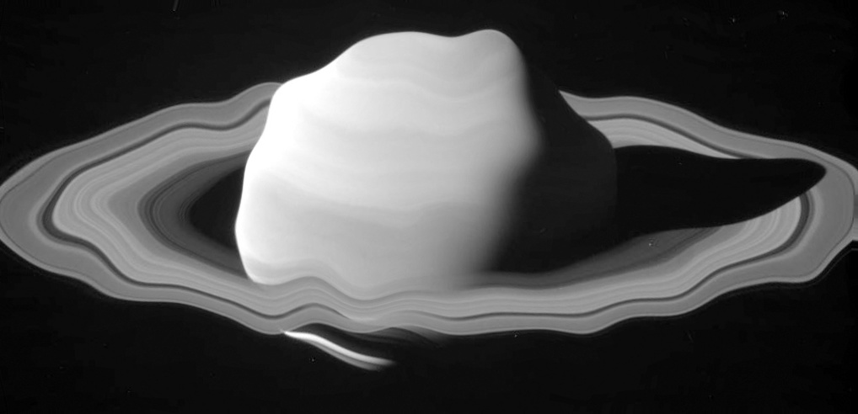
Accuracy in Analysis
Analyzing and interpreting any kind of data requires extensive validation
Improper interpretation of image data can likewise lead to inaccurate results

Slide 10
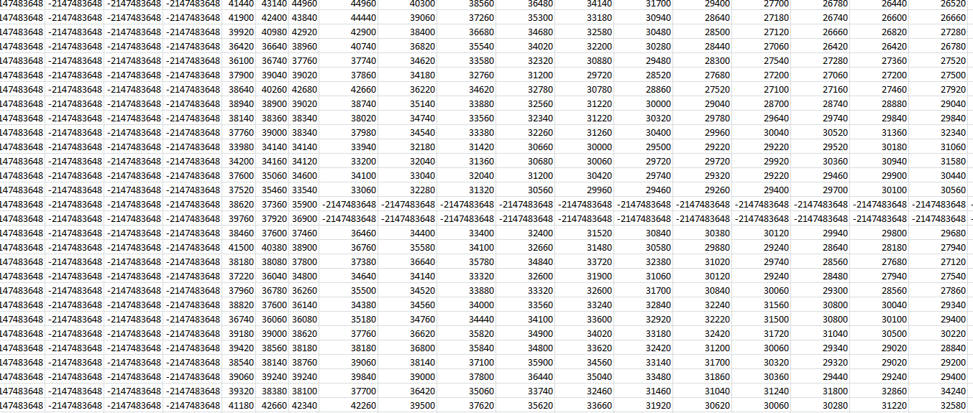
Cassini Data Challenges
Signal data traveled 890 million miles to reach Earth
Long time in transmission can lead to data degradation and data loss
Signal noise is much more prevalent

Slide 11
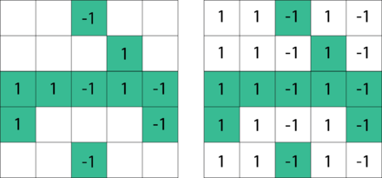
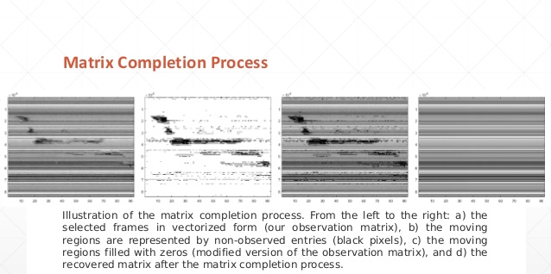
Machine Learning Approaches
Matrix factorization could be used to complete missing information
Sobral, A.C., (2016, June 27). Comparison of Matrix Completion Algorithms for Background Initialization in Videos. Retrieved from https://www.slideshare.net/andrewssobral/comparison-of-matrix-completion-algorithms-for-background-initialization-in-videos

Slide 12
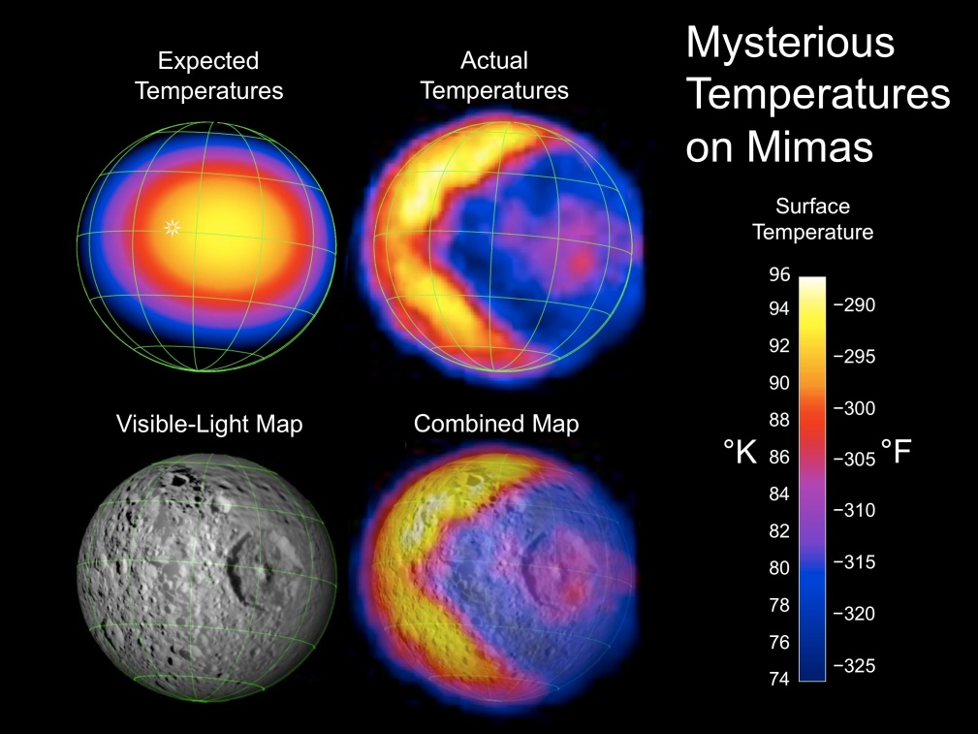
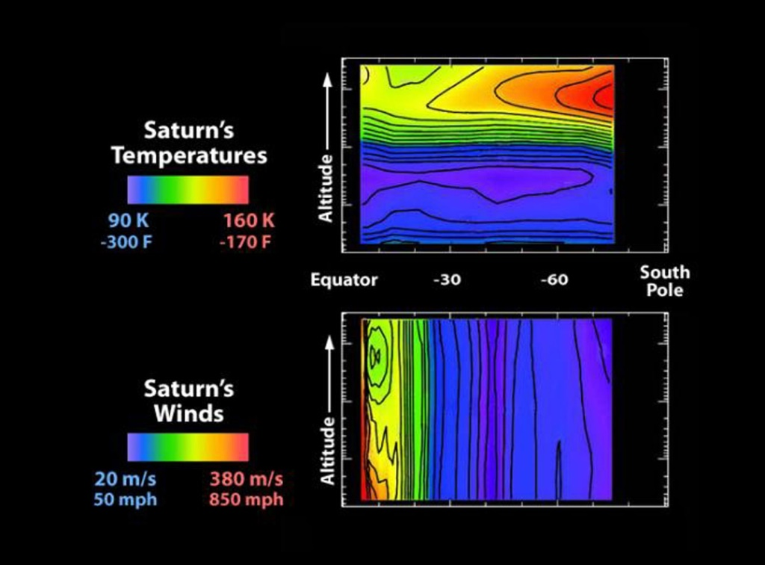
Additional Data Collected

Slide 13
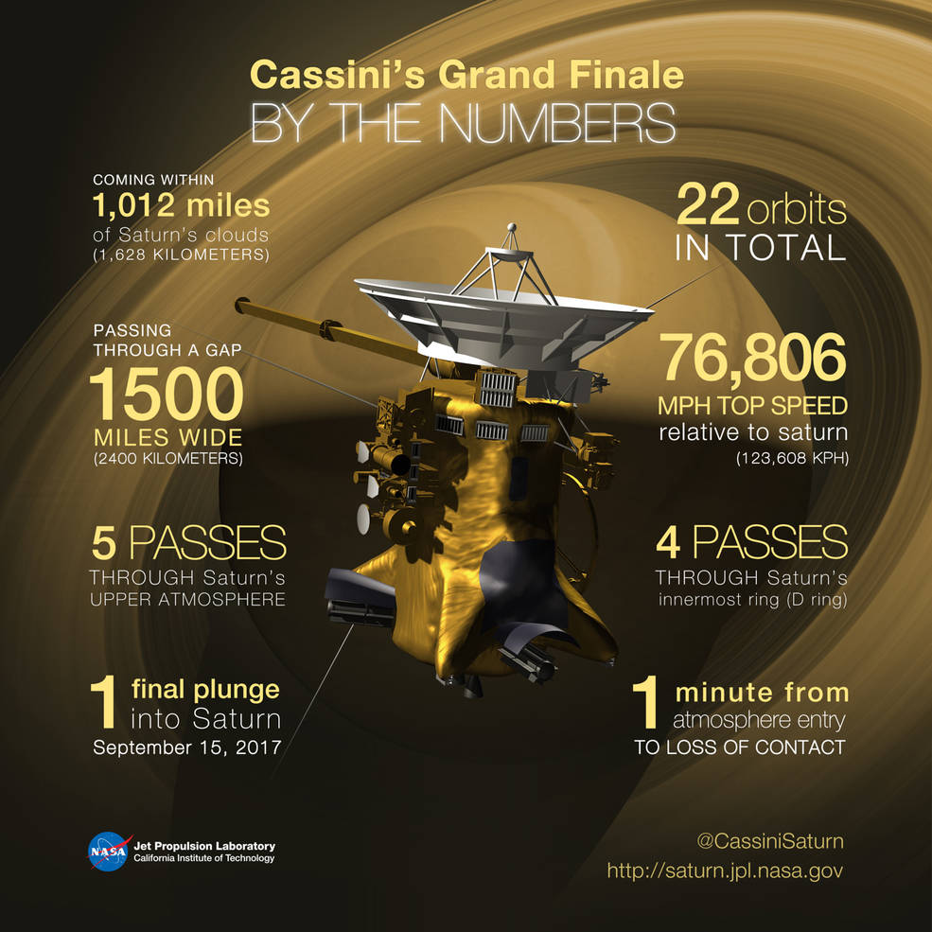
Cassini Summary

